Slide 1

MINI PROJECT MEDICAL SITE APPLICATION

Slide 2
Procedure to make the website-:
First we created the login page by using HTML, CSS and PHP for styling the page.
In the page, the user can login.
When the user login , the user comes to the page where the user can get the list of items and the information such as item code, price, type, grams, brand name etc.

Slide 3
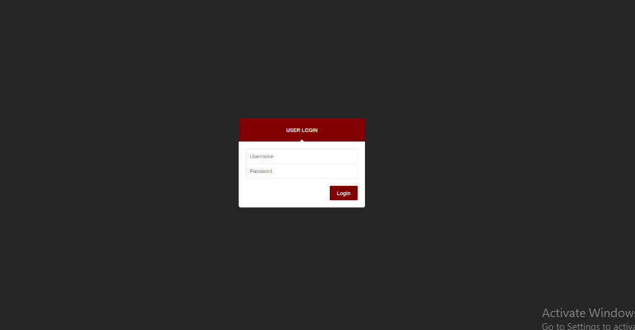
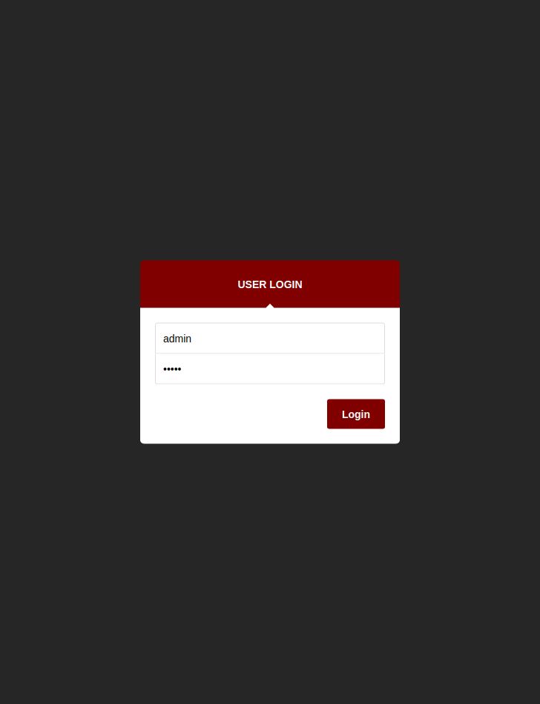
Admin(User) Login Page :

Slide 4
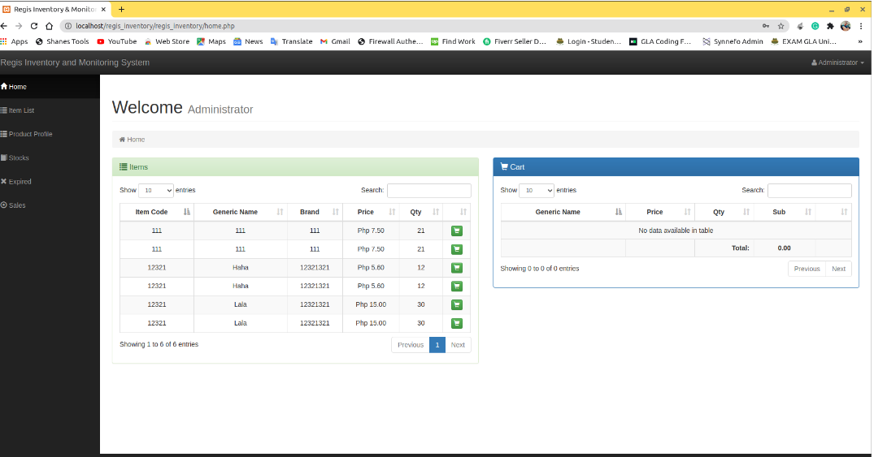
After the user login into his account he lands on the home page showing available
items, Shopping cart.
He also has other options on the side bar such as Items list, Product Profile,
Stocks, Expired, sales.

Slide 5
Transaction Addition
There is also the feature in the website that the user can enter the quantity of item and according to it the bill is calculated and then the alert message is shown – Transaction is added successfully.
User can also Add items into the the cart by clicking on the shop icon by typing the quantity of that item.

Slide 6
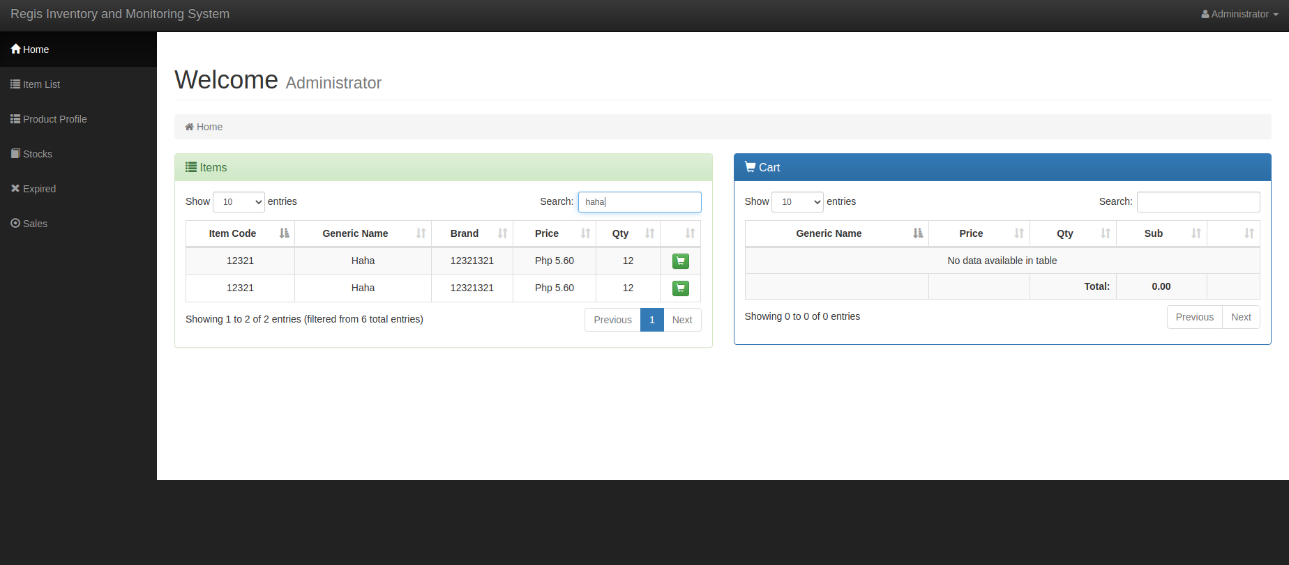
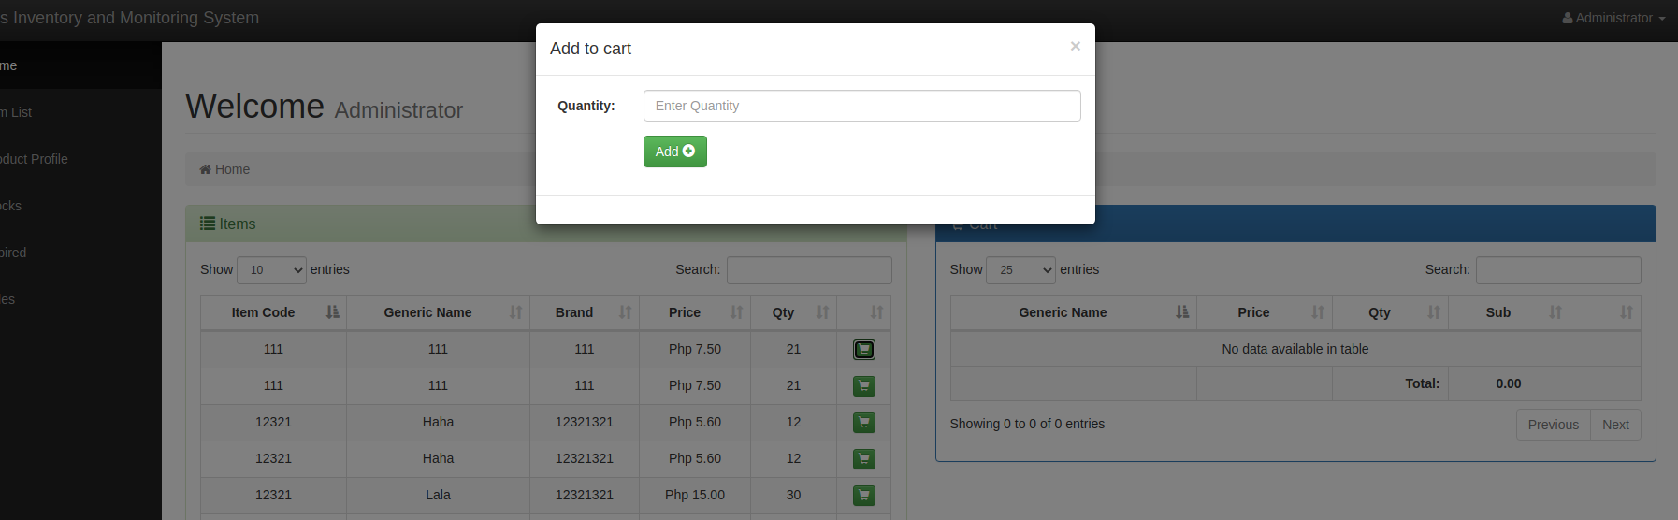

Slide 7
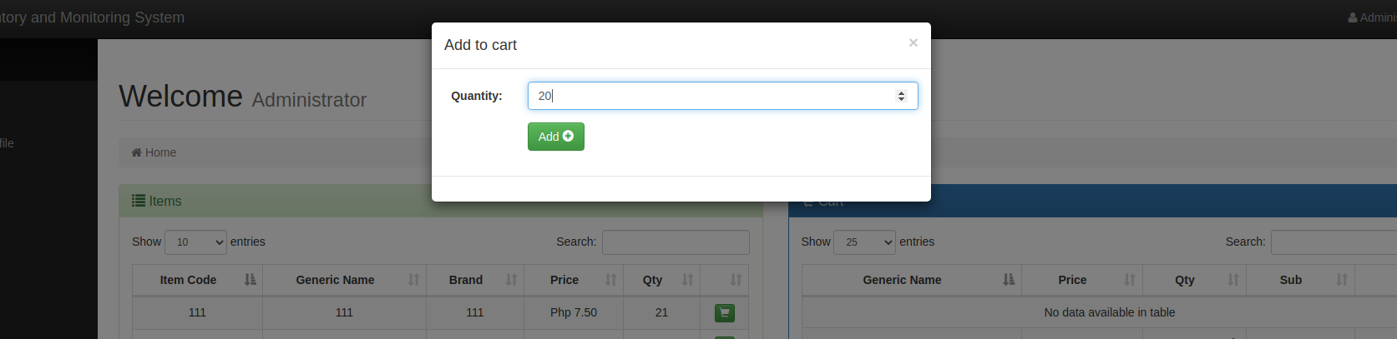
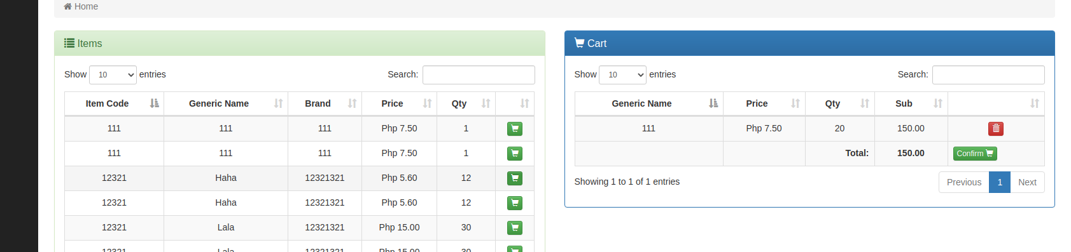


Slide 8
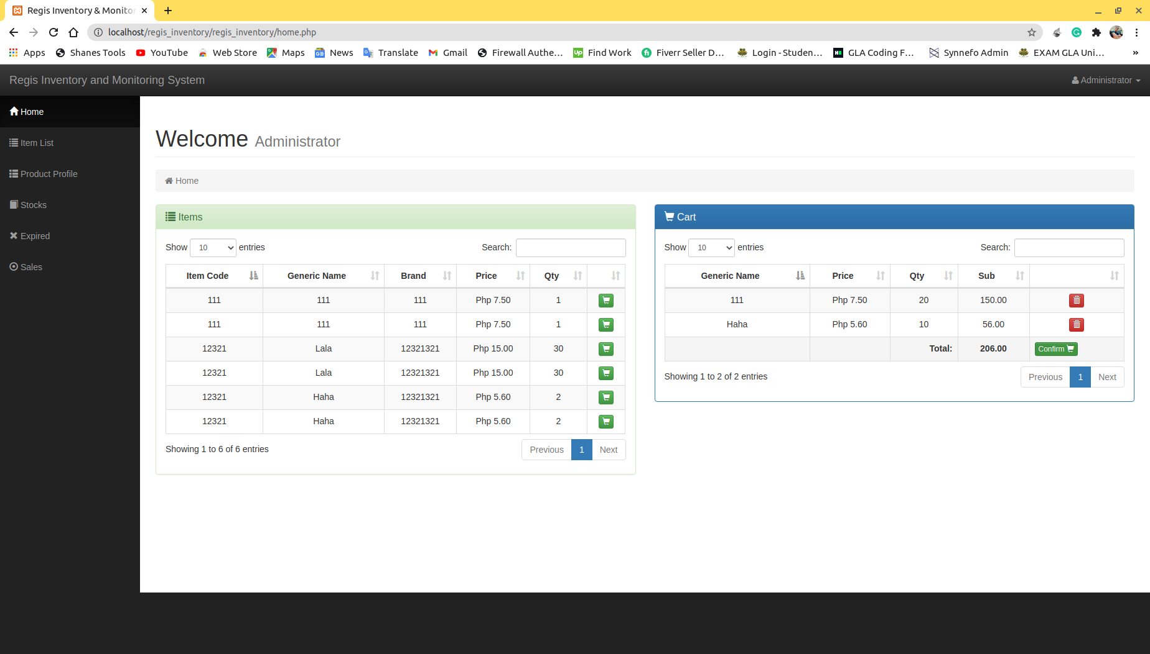
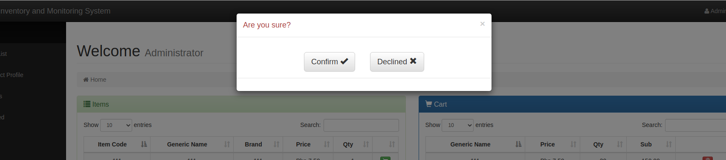
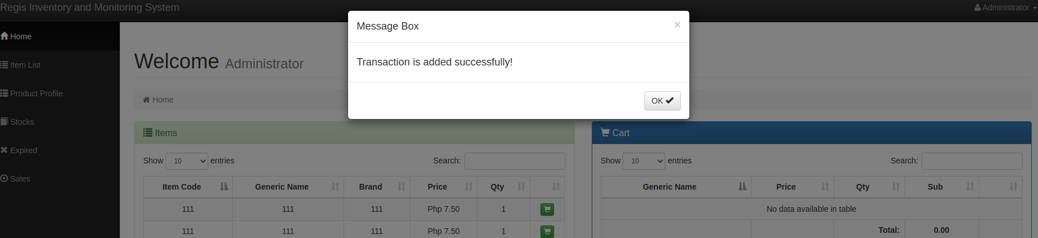

Slide 9
Addition of new items
There is also the feature in the website that the user can add new items according to the needs.
The user can add new item with its generic name, price, type, item code, grams, brand name etc.
Also, user can edit details about the previously added items.

Slide 10
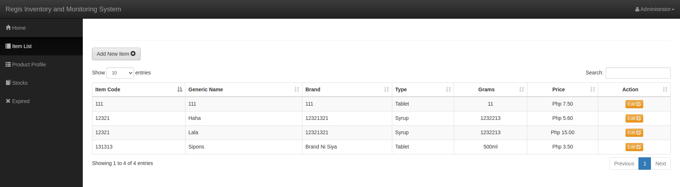
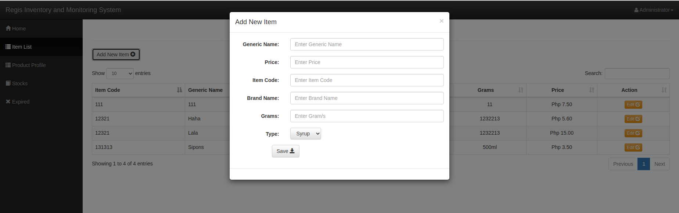

Slide 11
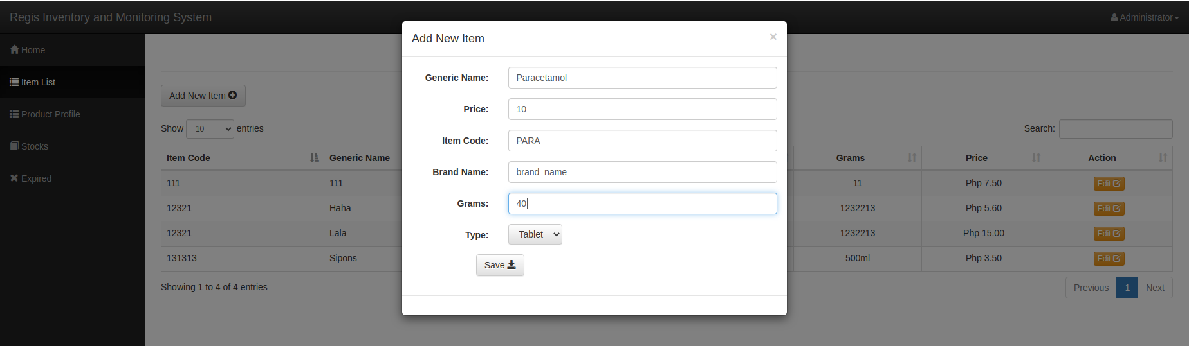
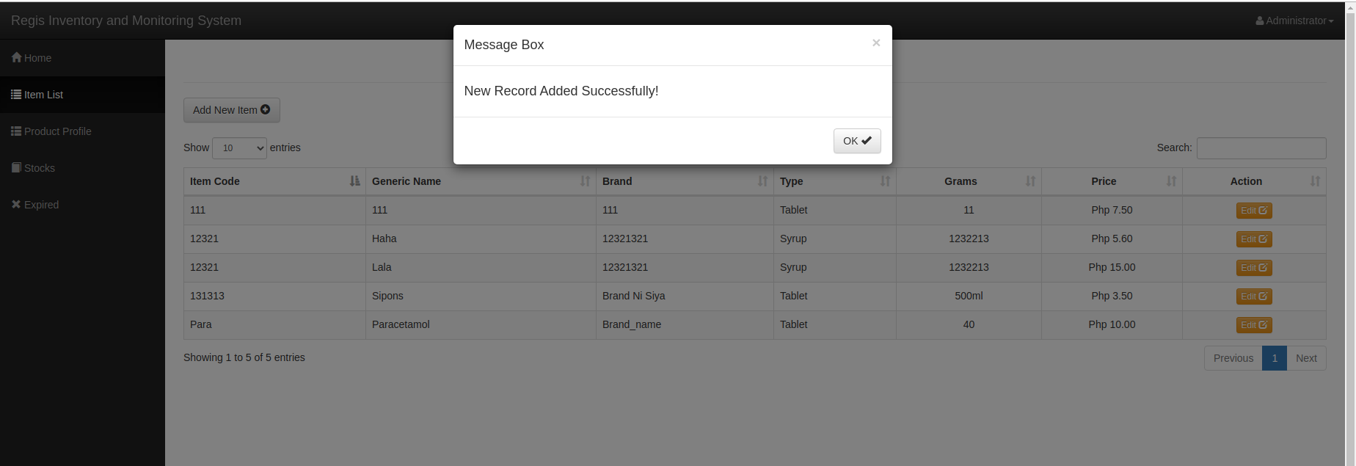

Slide 12
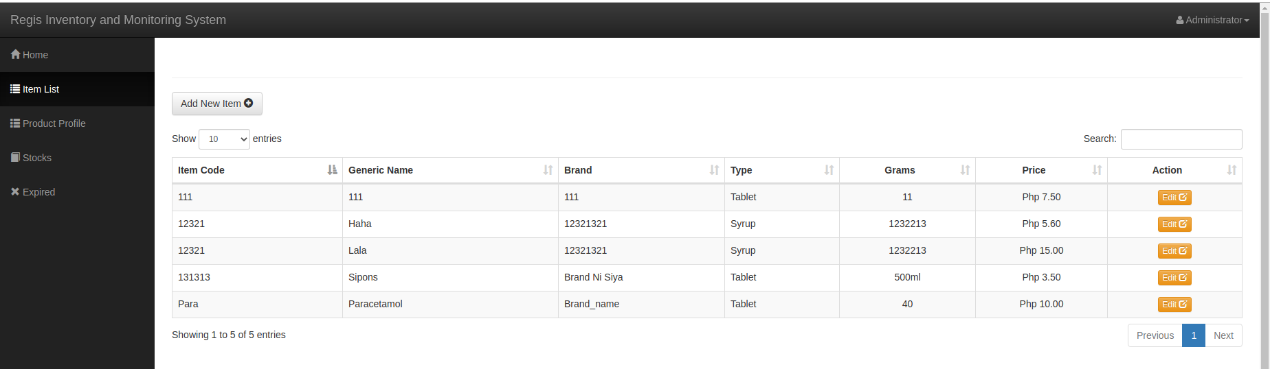
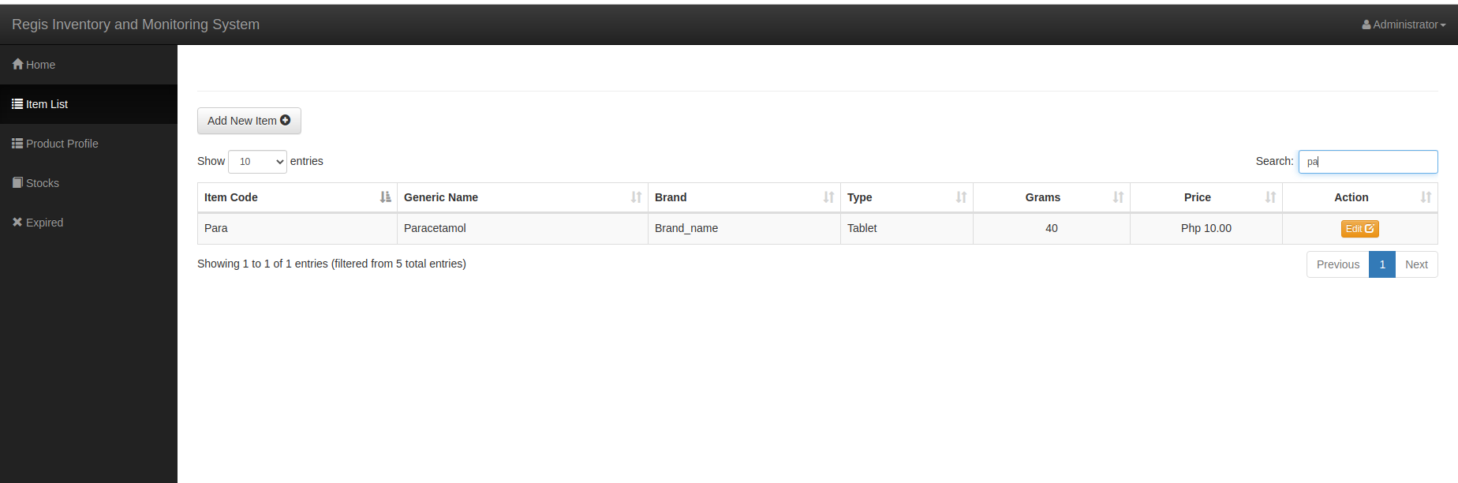

Slide 13
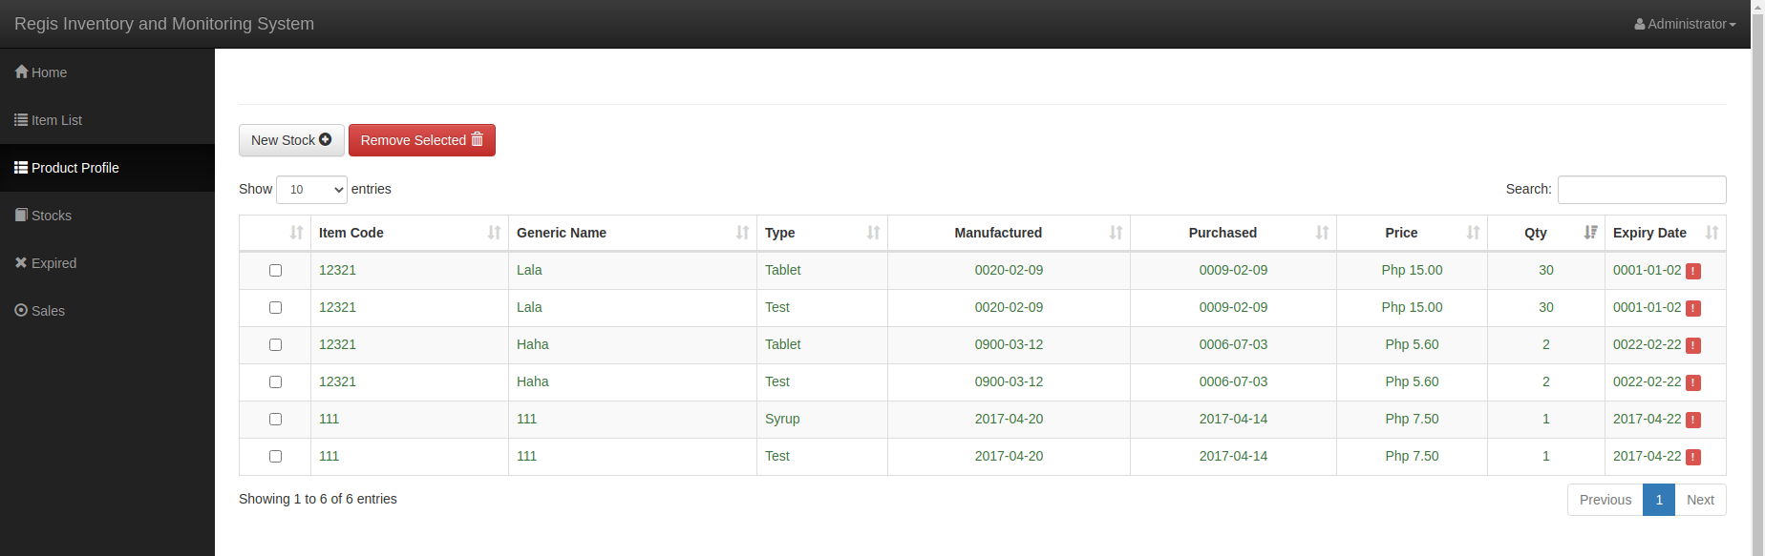
Addition & Deletion of stocks
The user can add new stocks of any product present under product profile by selecting the product, typing quantity, manfacturing date, expiry date, purchased date of the item.

Slide 14
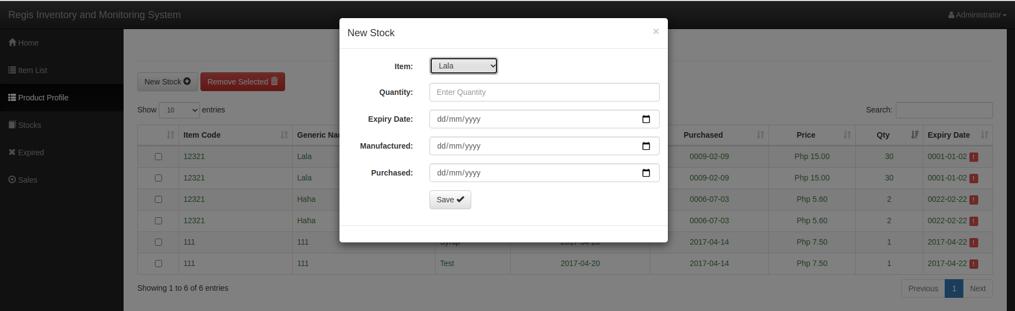
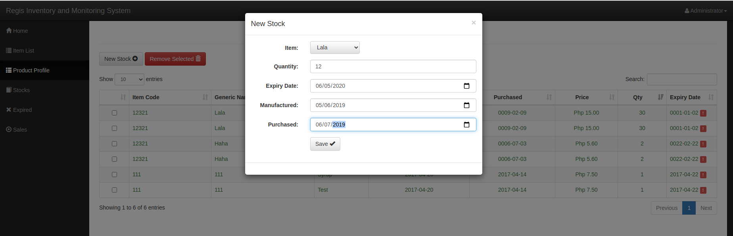

Slide 15
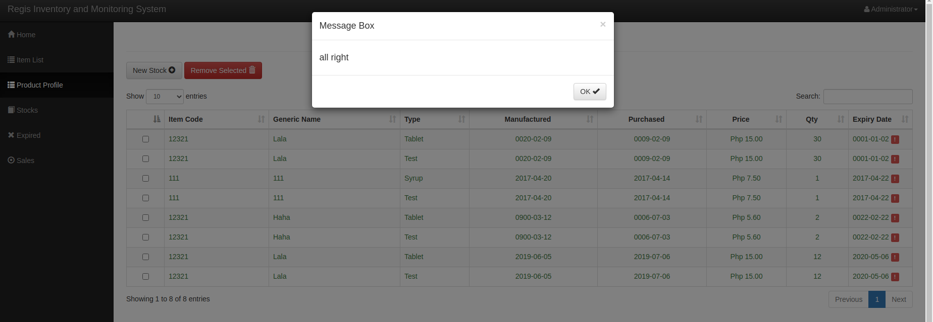
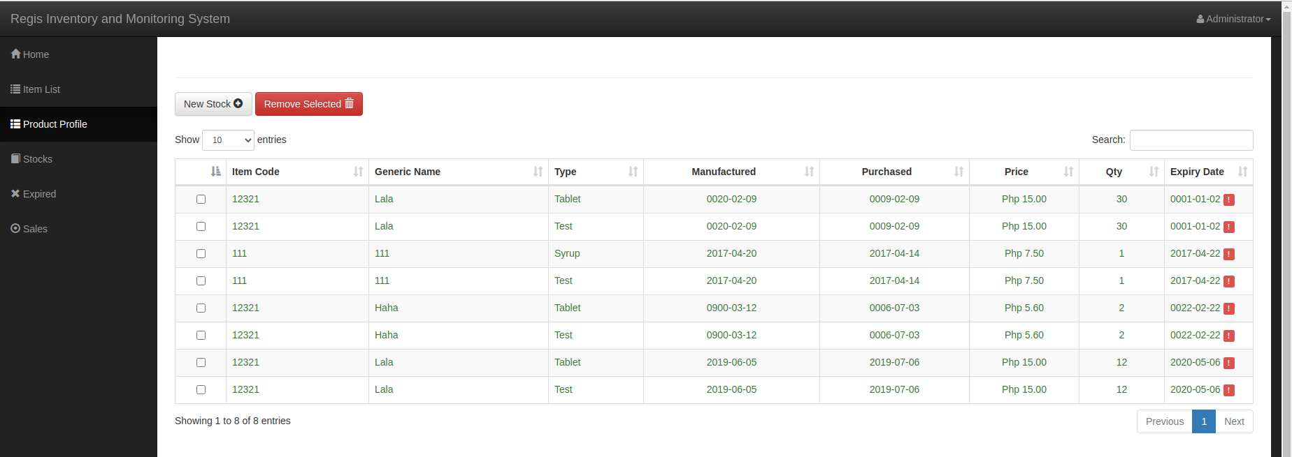

Slide 16
Additional Features of website-:
The user can also add the new stock according to the need.
The user can see the list of expired items with its expired date.
The user can also see the daily sales report.

Slide 17
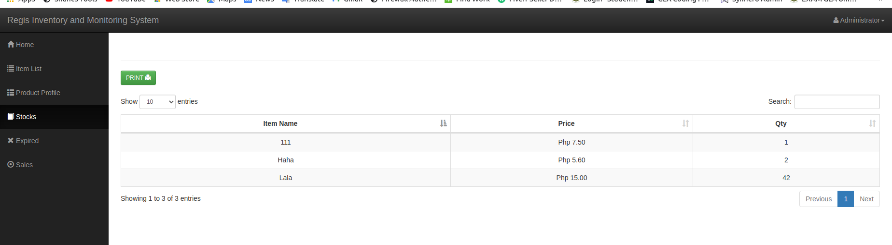
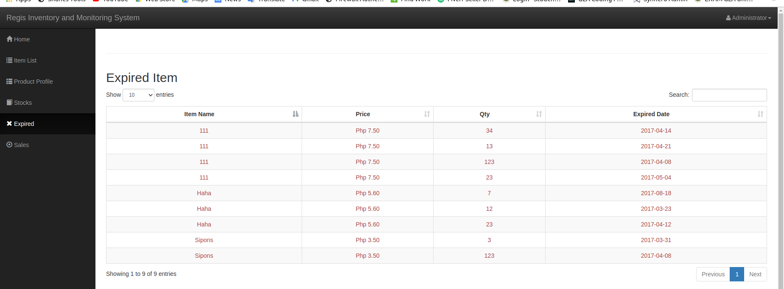

Slide 18
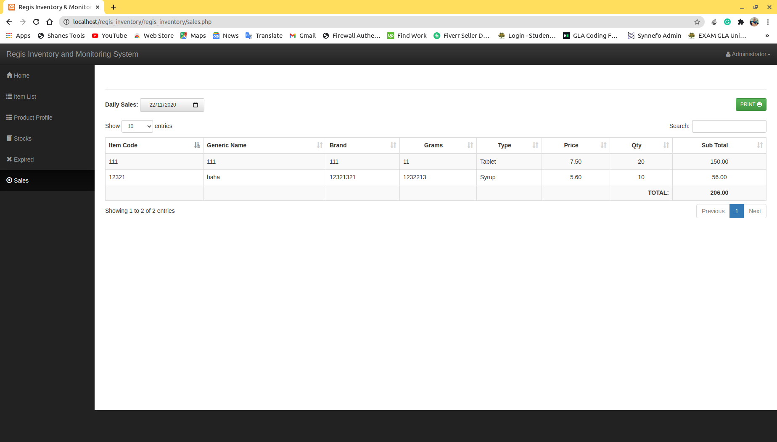

Slide 19
Technology used-:
XAMPP
MySQL
Front end web development -:HTML , CSS and Javascript.
PHP

Slide 20
Database Creation
After installing XAMPP -:
1. Create database.
2.Queries are imported into the database.
3.Import has been successfully finished. Many queries have executed.

Slide 21
Successful Completion
After all queries have executed, the website run correctly as we want. Also the front-end work – HTML, CSS, Javascript has been finished correctly.

